Slide 1
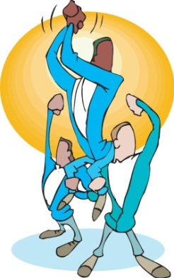


Generations Connected
What Today’s Employees Want From Workplace Communications
8/14/2012
1

Slide 2

A brave new world for employee communications … but
Digitally, people are connected like never before
… but some disturbing signs persist in workplace communication
TowersWatson 2012: only 35% really engaged
Aon/Hewitt survey … positive perception score
on employee communication declined 46%-42%
… biggest drop in any category measured
Employees want ‘personal touch’ at work ... but needs unfulfilled

Slide 3

A win-win for employees, management, communicators A win-win for employees, management, communicators
Employee view … what’s wrong in employee communication
Employee Issue Engagement Driver
“They don’t explain actions, how I fit in” CONNECT THE DOTS
“They give us too much fluff stuff” QUALITY INFORMATION
“They don’t tell me how I’m doing” PERFORMANCE FEEDBACK
“They don’t care about me, my ideas” LISTENING, IDEA SHARING
“They don’t recognize the work I do” RECOGNITION
“They say one thing, do another” TRUST

Slide 4


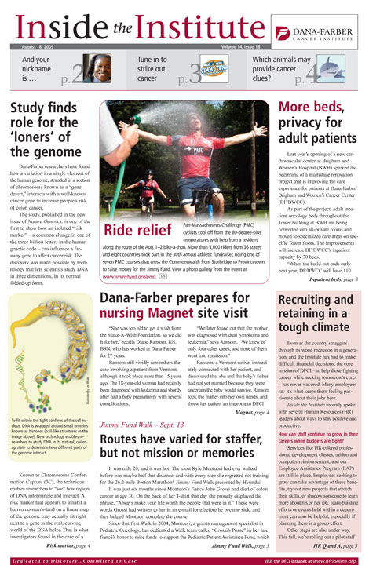
Employee communication today ... what you can do
Maintain a multi-media communication program
Email, intranet not the only games in town
Many generations in the workplace
… use a variety of channels to reach them
Practice an integrated approach to dissemination of information

Slide 5
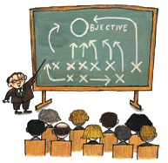

Employee communication today ... what you can do
Create a culture for frequent, effective face-to-face communication
“Can’t win hearts and minds with e-mail”
Train managers to upgrade communication skills
Support managers with info, guidance, attention
Establish a structured process for interaction
BUILD UNDERSTANDING AMONG MANAGERS:
“Communication … a powerful tool for competitive advantage”

Slide 6
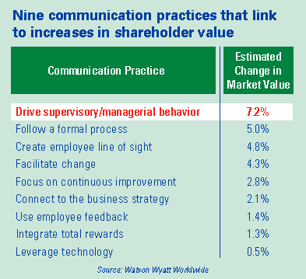
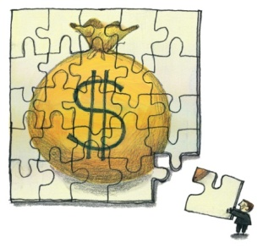
Employee communication today ... what you can do
The power of face-to-face: the proof is in the results
“Research shows … firms
that communicate
effectively are the best
financial performers.”
-- Towers Watson

Slide 7
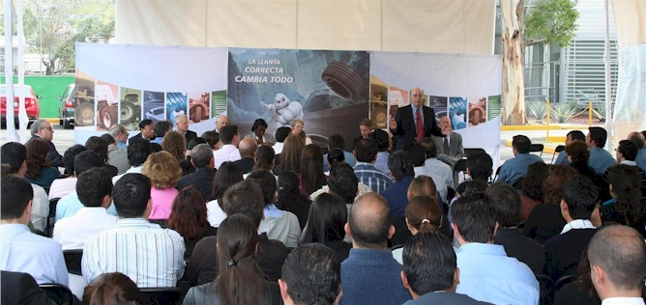
Things that work ... Michelin North America site visit program
President visits with all shop floor continuous improvement teams
Learns about projects, delivers messages, provides encouragement
Communicator keeps notes, IDs items for follow-up and action
Post-visit report distributed to President and key local plant staff
Leader’s tone, level of interest,
recognition builds momentum
for improvement, engagement

Slide 8
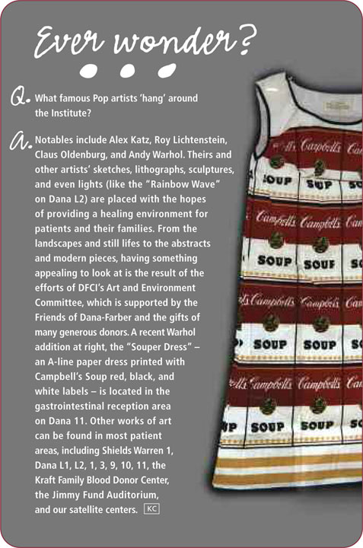

Employee communication … what you can do
Emphasize SIMPLICITY in all you communicate
Be sensitive to employee time pressures
CONTENT: Short, summarized, bulleted
> Write great headlines, subheads, quotes
> Put best info at the top
MESSAGING: 3-4 themes … repeat, reinforce
“Fire cannonballs
of clarity
to their foreheads”

Slide 9
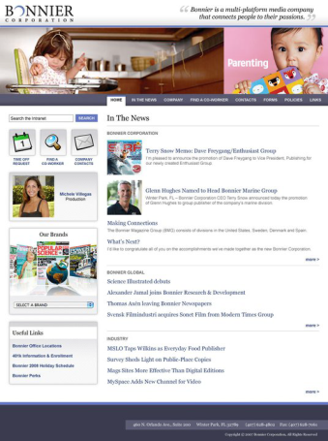
Things that work .. Intranet SIMPLICITY
What employees want from their intranet … SPEED
Fast, thorough, search engine and directories
Simple design … white space, icons, spot color
Ease in navigation … consistent, standardized throughout
Job-related content … helpful info, relevant to work tasks
Customization and mobility … like in their home life

Slide 10
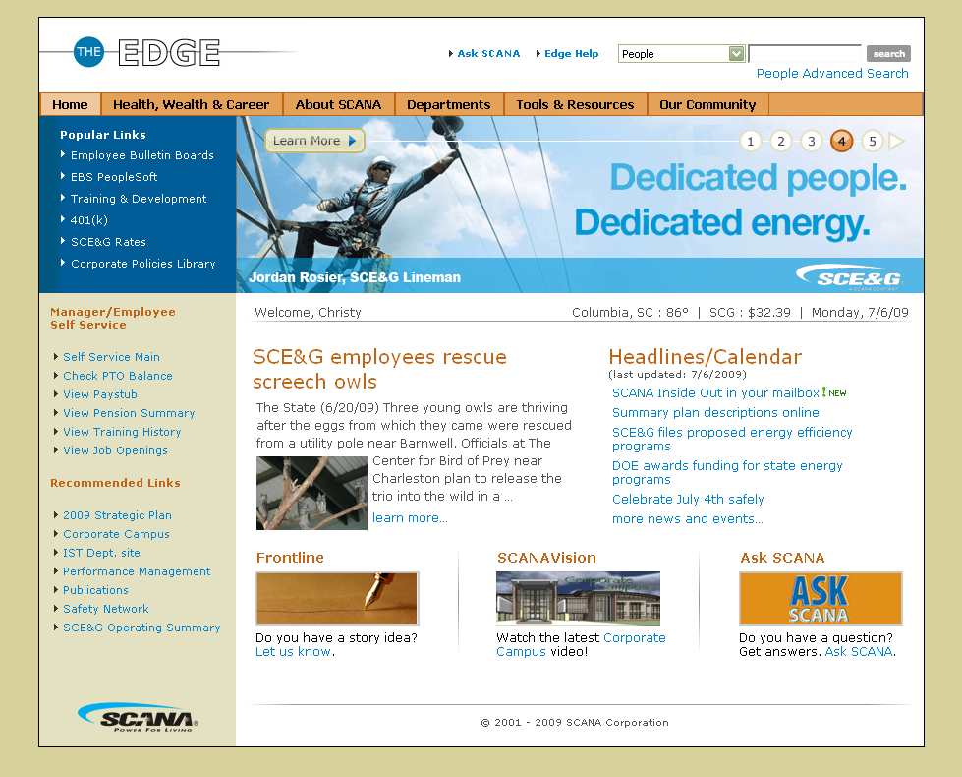
Things that work… the SCANA intranet
SIMPLICITY
Employee
input key
for
SCANA’s
acclaimed
intranet

Slide 11
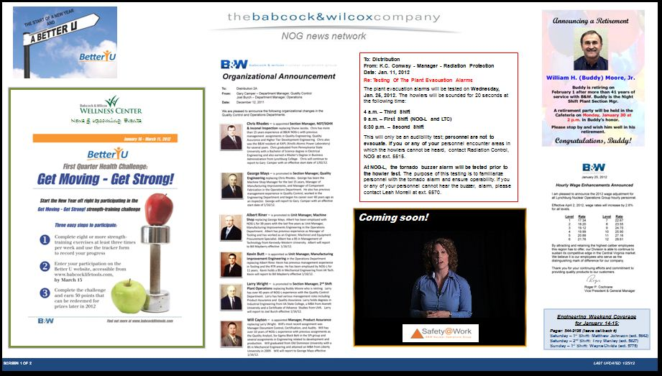
Things that work … digital signage systems
Some companies cobbled together their own system
Use PowerPoint software to create content
Video, animation used … 8-10 items per board, content rotated

Slide 12
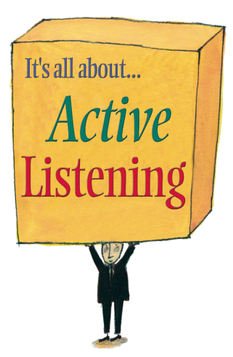
Employee communication … what you can do
LISTEN and LEARN from your employees
Spot surveys, focus groups, 1-1s, brown bags
Be truthful, complete, timely in your responses
Encourage leaders to engage in frequent 2-way dialogue
“You can hear a lot by listening”
“You can see a lot by observing”
– Yogi Berra

Slide 13
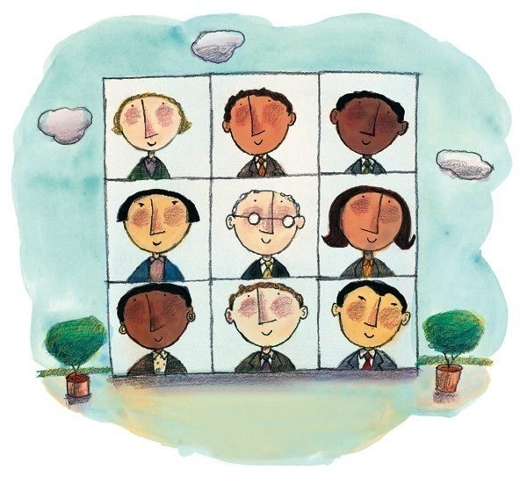
Things that work … Textron communication advisory council
Fabulous input method for communicators
8-10 employees per council, diverse group, 1 yr. term
Meet 4-6x’s a year … webcast or in person
Some ground rules up front
Feedback goes to leadership
Leaders often submit topics

Slide 14


Employee communication … what you can do
RECOGNIZE AND CELEBRATE … make employees the stars
Highlight individual, team accomplishments
Plentiful stories with employee quotes, photos
Celebrate milestones, marketplace successes

Slide 15
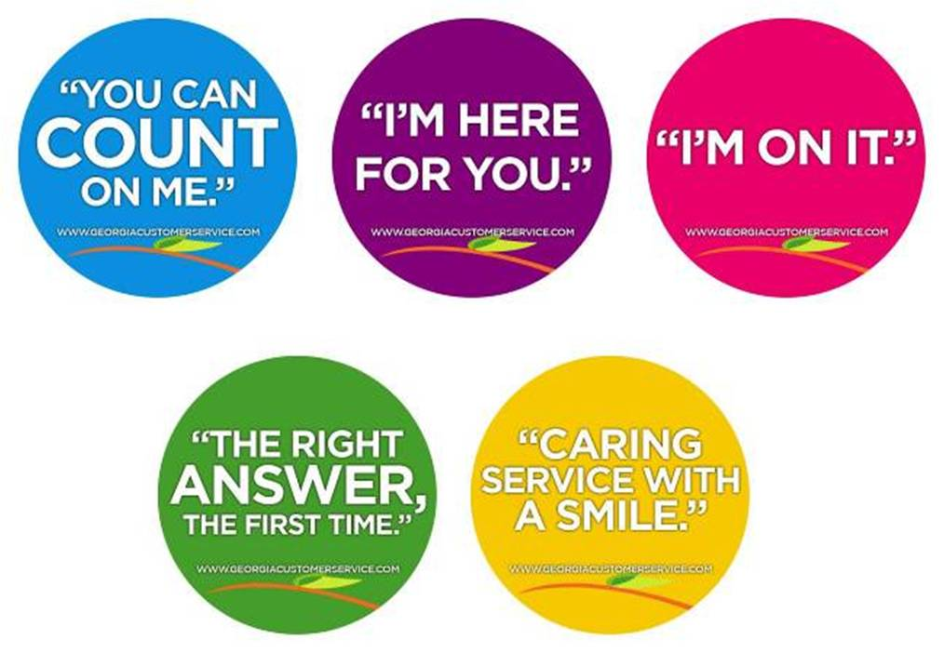

Things that work … Georgia customer service initiative
Employee teams formed to improve service, efficiency
’Champions’ help create communication plan, messages
‘Real’ personalized stories, tips, kudos
brought the campaign to life

Slide 16

Employee communication … what you can do
As communicators, acknowledge the INCLUSION revolution
BEFORE: Communicators created most of the content and used structured channels to deliver it
NOW: A more fluid approach … employees actively share information and snapshots of the organization
“Communicating at employees doesn’t work anymore.” – Jen Rock, Best Buy
“Communicators are moving from crafting the content to facilitating the discussion.” – Sharon MacIntosh, PepsiCo

Slide 17

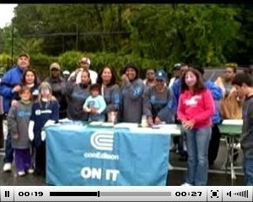
Things that work… the emergence of grassroots video
Video easier, cheaper to do … the age of the do-it-yourselfer
Grassroots video a popular method to engage employees
Internal YouTube-like channels spur employee involvement
> ConEd trains employees, gives them cameras
> Microsoft Podcast-in-a-Box employee rentals
Contests grow participation, interest
Communicators go out and film, too

Slide 18

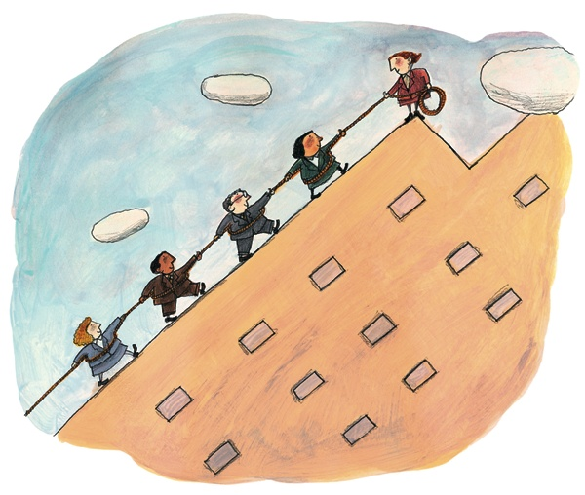
Employee communication … what you can do
Unleash the power of COLLABORATION
Digital age opens a new frontier for business effectiveness
Cyber age of instant learning, sharing, involving
IDEA SHARING drives speed, efficiency, service improvements
Ignites engagement, cultural change
Idea sharing ‘secret sauce’ for success
in many leading companies

Slide 19
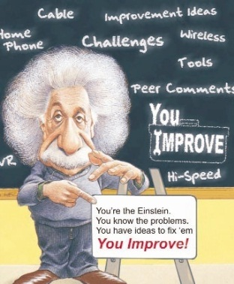

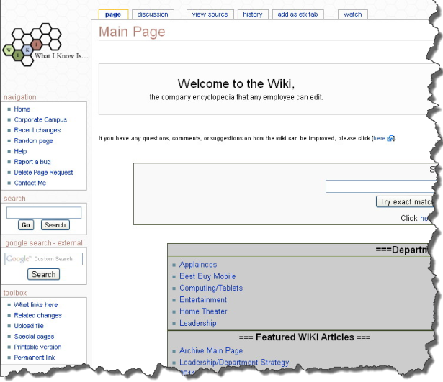
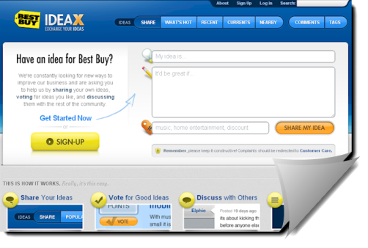
Things that work … online idea sharing programs
What’s happening elsewhere …
Rogers ‘You Improve’… home-grown, focused
Dell’s ‘Employee Storm’ … 45% participate daily,
real-time problem-solving
Best Buy ‘Idea X’ … customers interact
with employees, widespread wikis

Slide 20






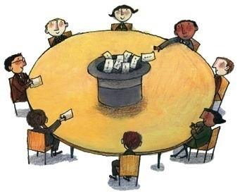

Things that work … online idea sharing programs
What’s happening elsewhere …
Orlando Health ‘Inspire Wire’ …
honors ‘good idea people’ in multiple ways
Finning ‘Big Ideas, Big Solutions’ …
integrates onsite discussion with CEO blog
Kraft Foods ‘Foodii’… Jell-O brainstorms

Slide 21
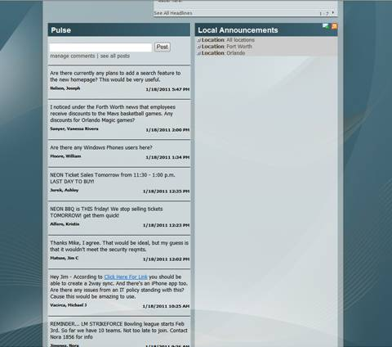
Things that work … employee microblogs
Lockheed Martin, Orlando, FL:
Twitter-like microblog The Pulse
Custom-coded SharePoint software
Brings a large global business together
Topics: Organization’s business plan,
team recognition, general queries
Contributes to speed, engagement

Slide 22
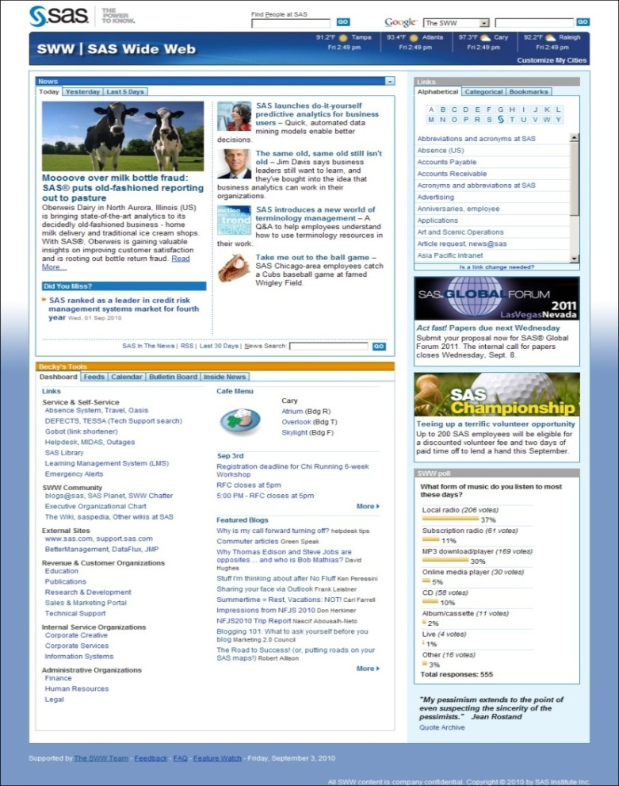
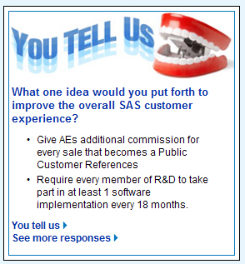

Things that work … social intranets
Conversation starts on home page
Dialogue now part of the culture
Customized news feeds
Communicators report ‘live’
Quizzes, Q’s build involvement
Increases intranet participation

Slide 23
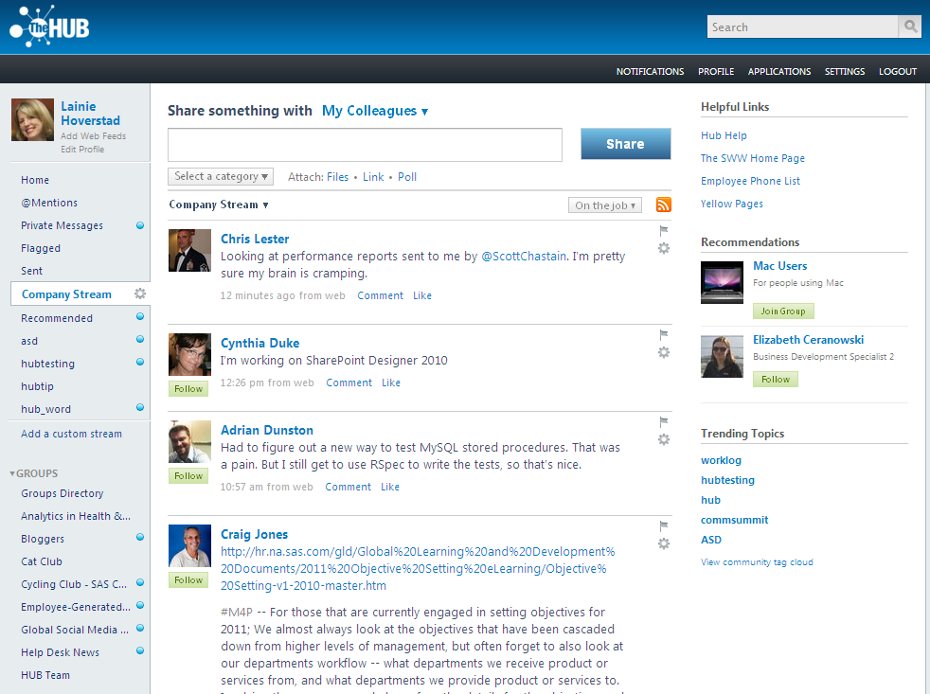
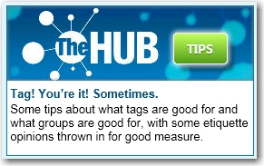
Things that work … SAS Intranet
The Hub: centralized ‘town center’ collaboration platform
All blogs, wikis, videos
are based here
VIBE … internal YouTube
Use social media to
stimulate innovation

Slide 24

Going forward … where do you go from here?
What you can do?
Educate yourself …
> Many communication resources: books, online
> Southeast Employee Communications Network
> Motiv8 updates: LinkedIn, Twitter (@writestuff1)
Push the limits … make a difference for your
organization … and yourself

